Slide 1

PILL BLISTER DETECTION MEHMET SEFA TOKSOY 220610035 ELIF CEYDA CİVELEK 220610011

Slide 2
Contents
Problem Definition
Literature Review
Algorithm Explanation & Libraries
Limitations and Time Restraints
Code Link and Live Demonstration
References

Slide 3

PROBLEM DEFINITION

Slide 4
PROBLEM DEFINITION
We want to solve a specific image recognition / computer vision problem in the medical field.
During medicine production, it is important to be able to count pill blisters (both used and full) to ensure a successful production flow.
With image recognition / computer vision techniques, we can complete this task without human supervision or labor.

Slide 5
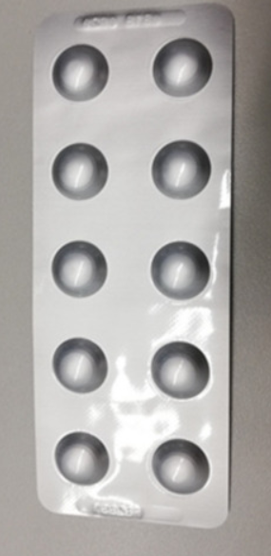
PROBLEM DEFINITION
How many pill blisters are there in this image?
This is what we are trying to solve.

Slide 6

LITERATURE REVIEW
Researching about our problem.

Slide 7
LITERATURE REVIEW
We have researched and found many articles tackling this kind of problem. Most sources recommend the usage of Machine Learning techniques, but we decided not to use this technology.
What we wanted with our solution is to not rely on machine learning, but to use image processing and computer vision methodology to guess blister locations quickly and consistently.

Slide 8
LITERATURE REVIEW
An interesting study came into light when we were researching articles for an answer. This article tackled the same problem we have and detailed the image processing methods they have used.^{[1]}
So, we decided to follow the instructions on this article and occasionally improve upon it when needed. This article contained many methodologies that we were not yet aware of like Hough Transform of Circles^{[5]}, CLAHE^{[3]} filter, etc.
We used OpenCV documentation^{[2]} to learn about those methodologies that we hadn’t yet known.

Slide 9

ALGORITHM EXPLANATION & LIBRARIES
How the code works.

Slide 10
ALGORITHM EXPLANATION
Our algorithm works in three stages:
Image Acquisition
Image Preprocessing
Detection & Counting

Slide 11
1. IMAGE ACQUISITION
First step to our algorithm is to limit our working area to reduce background artifacts and scale our image up. We can use Image Segmentation methods to establish a bounding box for our pills, crop out background pixels, scale our image and rotate our image to be vertically aligned.

Slide 12
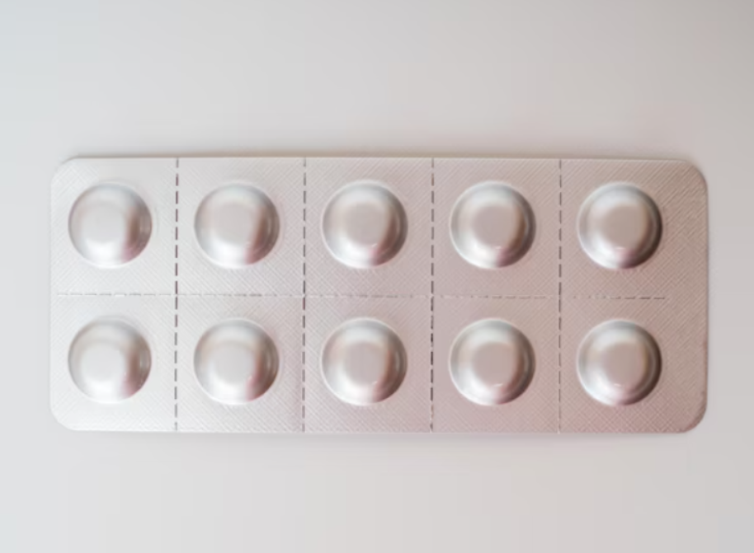
Image before Image Acquisition step.

Slide 13
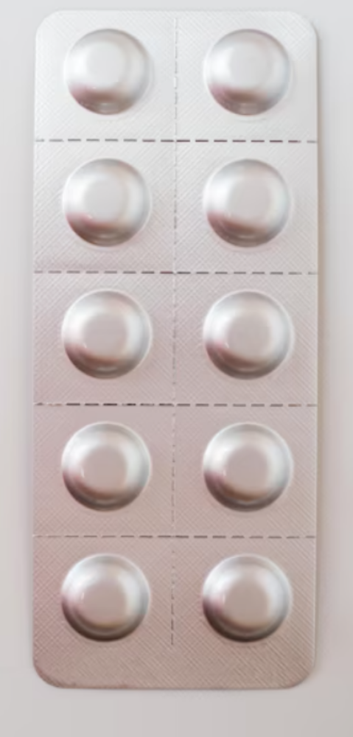
Image after Image Acquisition step.
(Useless background pixels removed,
scaled and rotated.)

Slide 14
1. IMAGE ACQUISITION
To do this, we first load our image, convert it to grayscale and apply a 5x5 Mean filter over it to reduce artifacts.
Then, we use a 9x9 Local Standard Deviation filter to show edges in our image. To improve precision, we use OTSU global threshold to convert our image to binary image.
We dilate our binary image using a 50x50 dilation filter and then connect closed gaps using morphology.
Using image contours, we can find the largest bounding box and mark it as our pills. We can then crop this region and scale/rotate it accordingly.

Slide 15
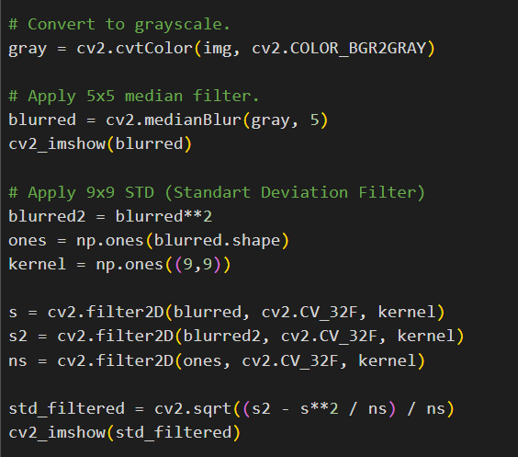

Slide 16
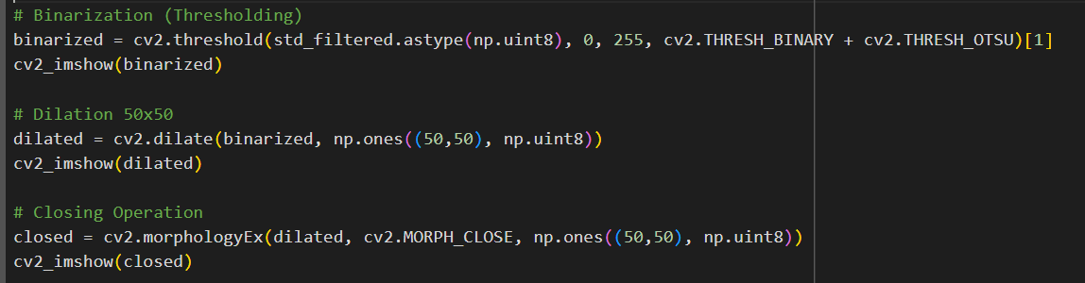

Slide 17
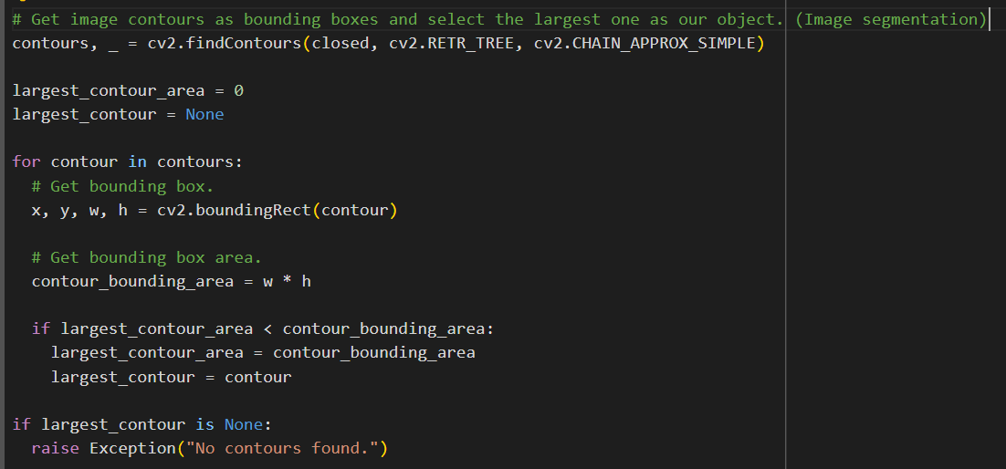

Slide 18
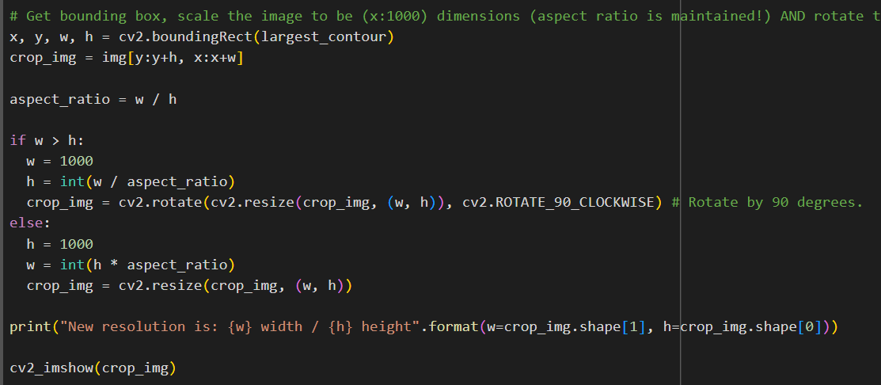

Slide 19
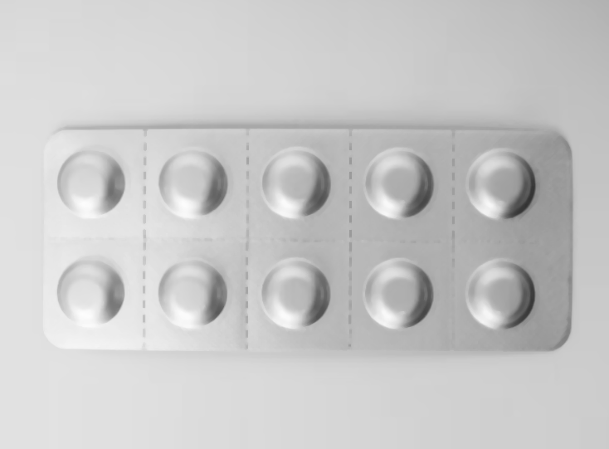
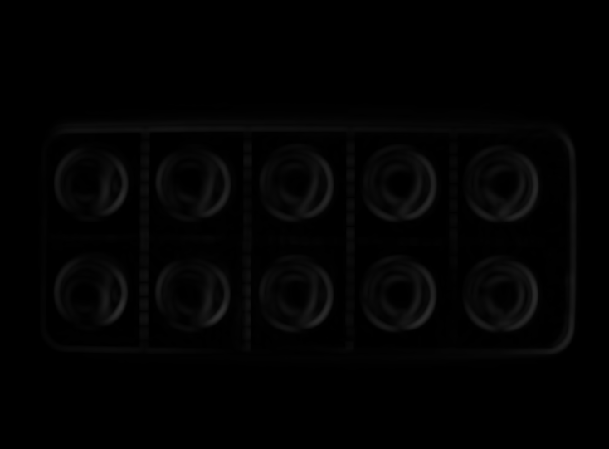
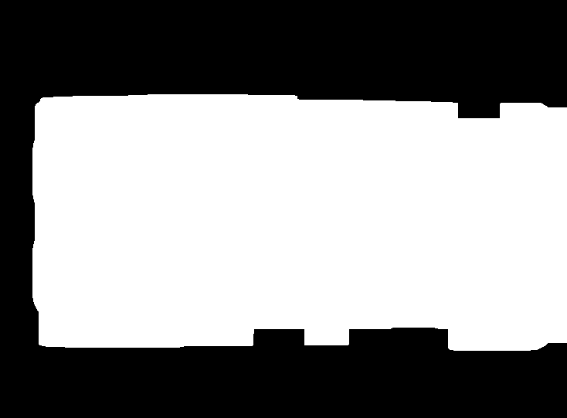

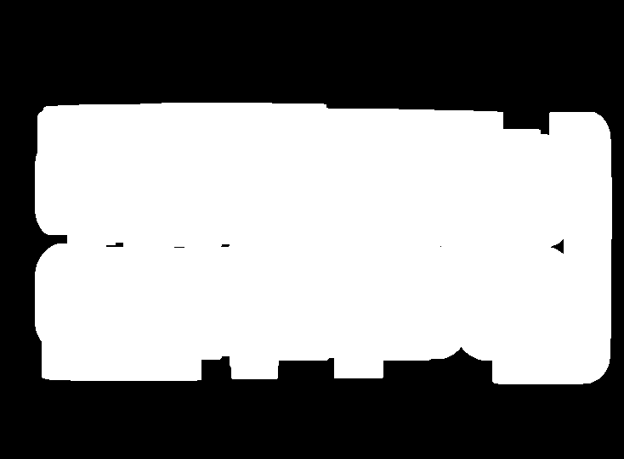
1
2
5
3
4

Slide 20
2. IMAGE PREPROCESSING
Great, now our image is cropped and in a consistent resolution. Now, we can move onto Image Preprocessing step.
In this stage, we use various filters on our cropped image to make it more suitable for detection. The aim here is to bring out low level features such as edges more and reduce artifacts (such as reflections).

Slide 21
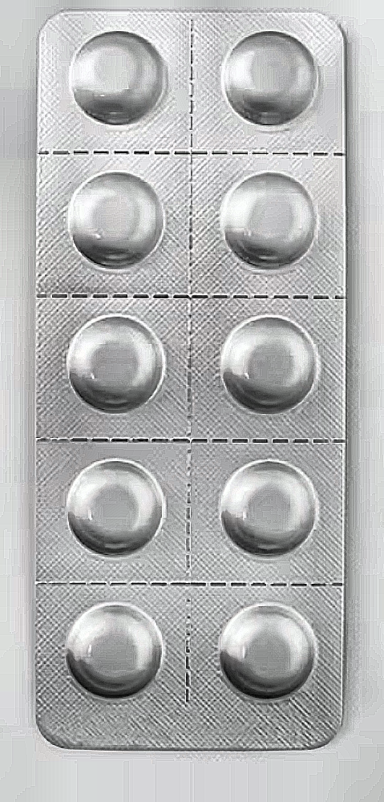

Image Preprocessing

Slide 22
2. IMAGE PREPROCESSING
To do this, we first convert our color space from RGB to HSV.
We, then, apply Contrast-Limited Adaptive Histogram Equalization (CLAHE)^{[3]} filter on all three channels (hue, saturation, value) of our image to reduce illumination/reflections.
After, we apply a sharpening filter on the value (V) channel to highlight contrast in the image for better edge detection.

Slide 23
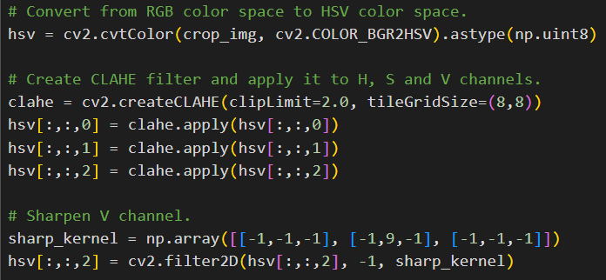

Slide 24
3. DETECTION & COUNTING
Now, our image is ready for detection. All previous steps have been building up to this step and this is the most important step of our algorithm.
The aim here is to find all circular shapes in our image and select the ones that are in range. This is where it starts to get inconsistent and produce wrong/inaccurate results.

Slide 25
3. DETECTION & COUNTING
First step is to run a Canny Edge Detection^{[4]} algorithm to find all edges in our image.
Then, we run a Hough Transform of Circles^{[5]} algorithm to detect circular shapes in our filtered image. The detected circles are counted as blisters.
These two algorithms can produce very inaccurate results when our object is rotated or not perfectly perpendicular to the camera.

Slide 26
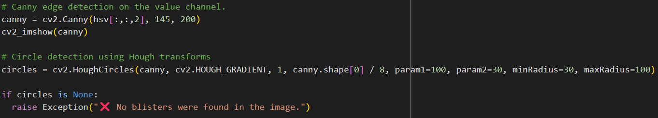

Slide 27
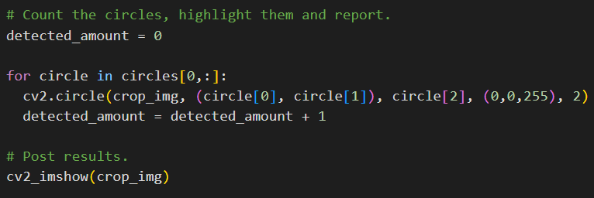

Slide 28
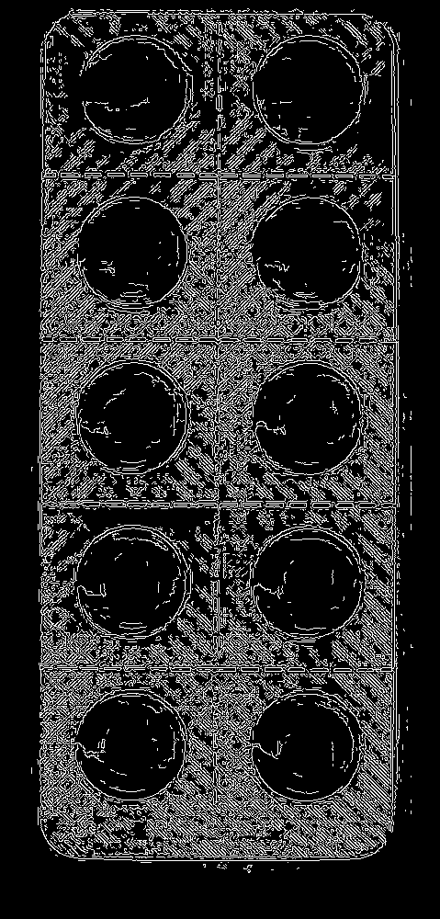
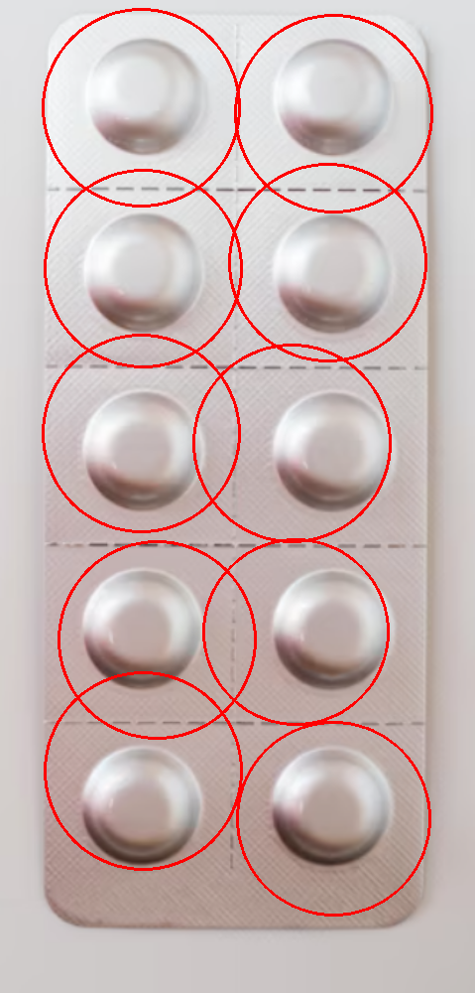

Slide 30
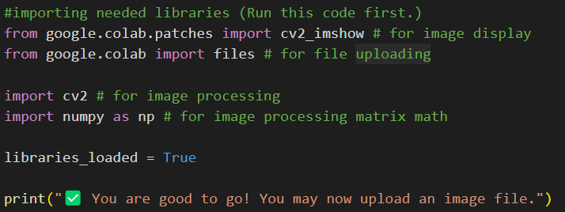
LIBRARIES USED
Google colab libraries were used for image display and file uploading.
OpenCV library used for image processing and computer vision.
NumPY library used for matrix math.

Slide 31
LIMITATIONS AND TIME RESTRAINTS
Limitations of our algorithm and time restraints to work on it.

Slide 32

TIME RESTRAINTS
Due to only being a two-member group and strict time restraints, we produced an application that only counts blisters.

Slide 33
ALGORITHM LIMITATIONS
Our algorithm doesn’t use machine learning and works off image processing alone. This fact alone limits how flexible the detection is.
Since our algorithm uses Hough Transform of Circles algorithm to detect blisters, it is unable to detect blisters of any other shape other than circles.

Slide 34
ALGORITHM INACCURACIES
Reflections, glare, rotation and noise in our source images can greatly impact the accuracy of the algorithm. Noise is especially a big problem as it produces very inaccurate results.
Not only that, selecting a proper circle range can prove to be difficult as well and may introduce more inaccuracies.
Here, we highlighted the results from multiple images. You can see how well the algorithm performed for each one.

Slide 35
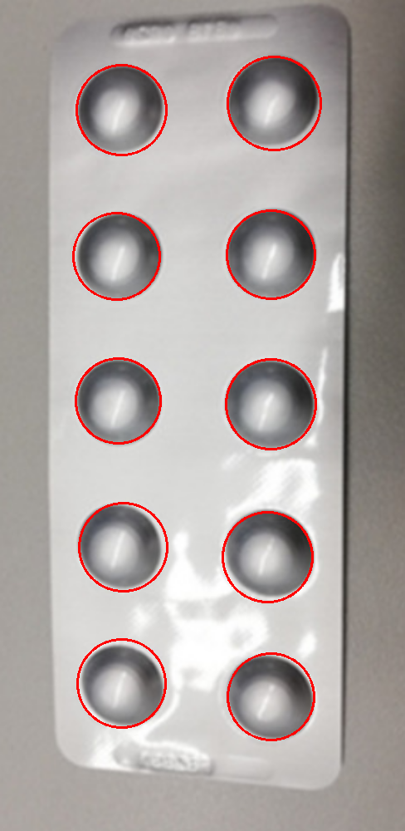
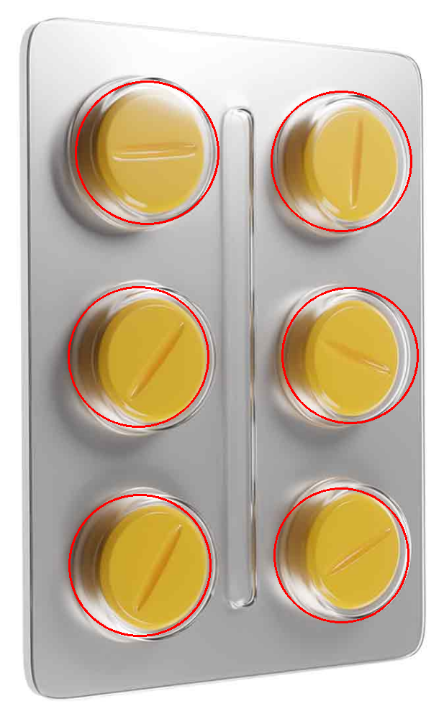

Slide 36
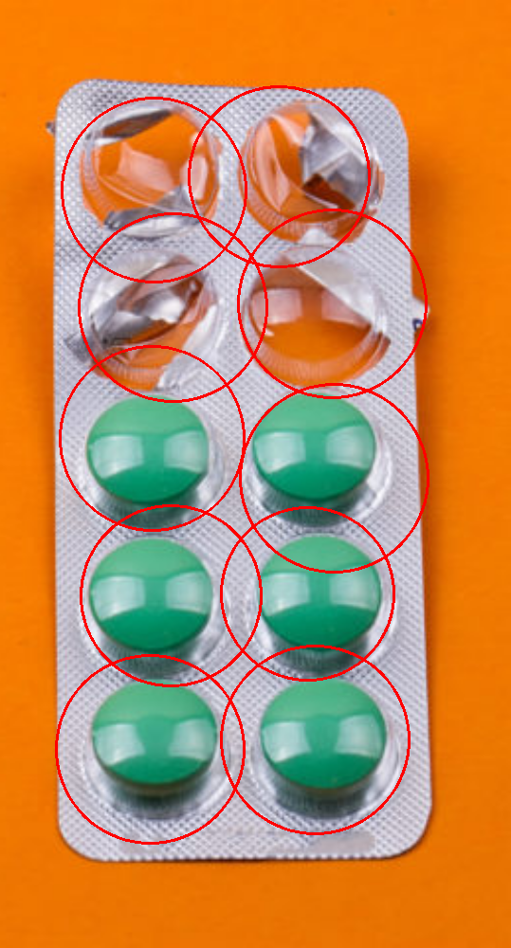
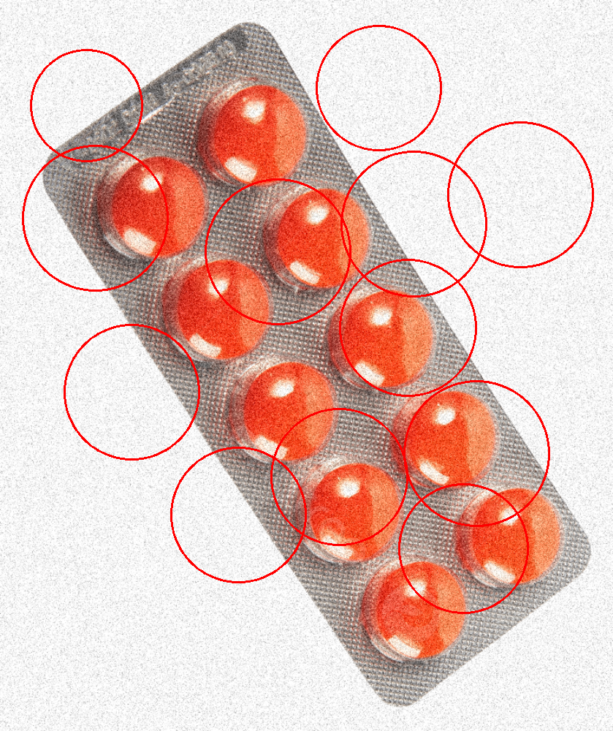

Slide 37
WAYS TO IMPROVE
Algorithm could be improved by taking noise into account more and detecting circle dimensions automatically (right now, it is rather manual to produce best results.)
Other image detection strategies could be employed like template matching to match more blister types.
Machine learning strategies could be employed to match even more blister types with more accuracy.

Slide 38

CODE LINK AND LIVE DEMONSTRATION

Slide 39
CODE LINKS AND LIVE DEMONSTRATION
Google Colab link: https://colab.research.google.com/drive/196VO94BkJuiJdB2D27xYExGbeIfInuWh?usp=sharing
GitHub link: https://github.com/SefaWork/PillBlisterCounter

Slide 40
REFERENCES
[1] Holtkötter, J., Amaral, R., Almeida, R., Jácome, C., Cardoso, R., Pereira, A., Pereira, M., Chon, K. H., & Fonseca, J. A. (2022b). Development and validation of a Digital Image Processing-Based Pill Detection Tool for an Oral Medication Self-Monitoring System. Sensors, 22(8), 2958. https://doi.org/10.3390/s22082958
[2] OpenCV. (2024, June 1). OpenCV - Open Computer Vision Library. https://opencv.org/
[3] OpenCV: Histograms - 2: Histogram Equalization. (n.d.). https://docs.opencv.org/4.x/d5/daf/tutorial_py_histogram_equalization.html
[4] OpenCV: Canny Edge Detection. (n.d.). https://docs.opencv.org/3.4/da/d22/tutorial_py_canny.html
[5] OpenCV: OpenCV: Hough Circle Transform. (n.d.). https://docs.opencv.org/4.x/da/d53/tutorial_py_houghcircles.html

Slide 41
Thank You!

